Slide 1

机密容器的实现技术详解及应用探讨
Notes:
Monolina will intro session and speakers
Links to some existing content

Slide 2
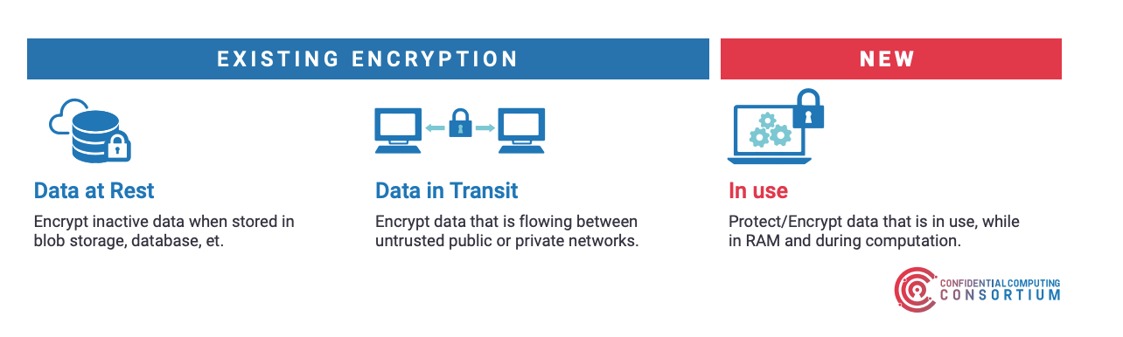
什么是机密计算？
https://confidentialcomputing.io/wp-content/uploads/sites/10/2023/03/CCC_outreach_whitepaper_updated_November_2022.pdf
Notes:
简单聊一下机密计算社区的发展，成员的构成，霍老师的社区工作等。
"Confidential Computing protects data in use by performing computation in a hardware-based Trusted Execution Environment. These secure and isolated environments prevent unauthorized access or modification of applications and data while they are in use, thereby increasing the security level of
organizations that manage sensitive and regulated data.
A Trusted Execution Environment (TEE) is commonly defined as an environment that provides a level of
assurance of data integrity, data confidentiality, and code integrity. A hardware-based TEE uses
hardware-backed techniques to provide increased security guarantees for the execution of code and
protection of data within that environment."
Key Characteristics of Confidential Computing (defined by Confidential Computing Consortium)
Data confidentiality: Unauthorized entities cannot view data while it is in use within the TEE
Data integrity: Unauthorized entities cannot add, remove, or alter data while it is in use within the TEE
Code integrity: Unauthorized entities cannot add, remove, or alter code executing in the TEE
Red Hat is investing in 4 projects / task forces
Confidential Workloads ( Podman , guest level)
Create confidential services without the need to migrate conventional containers
Confidential Container (CoCo, guest level)
The goal of the CoCo project is to standardize confidential computing at the container level and simplify its consumption in Kubernetes.
Peer Pods is GA ( https://access.redhat.com/documentation/en-us/openshift_sandboxed_containers/1.5 )
Confidential Virtualization (RHEL Host Enablement)
Enable OpenShift Virtualization to start Confidential VMs
Confidential Cluster
Combine a set of Confidential VMs into one secure Cluster

Slide 3

Red Hat 平台目前为机密计算提供了哪些基础能力？

Slide 4
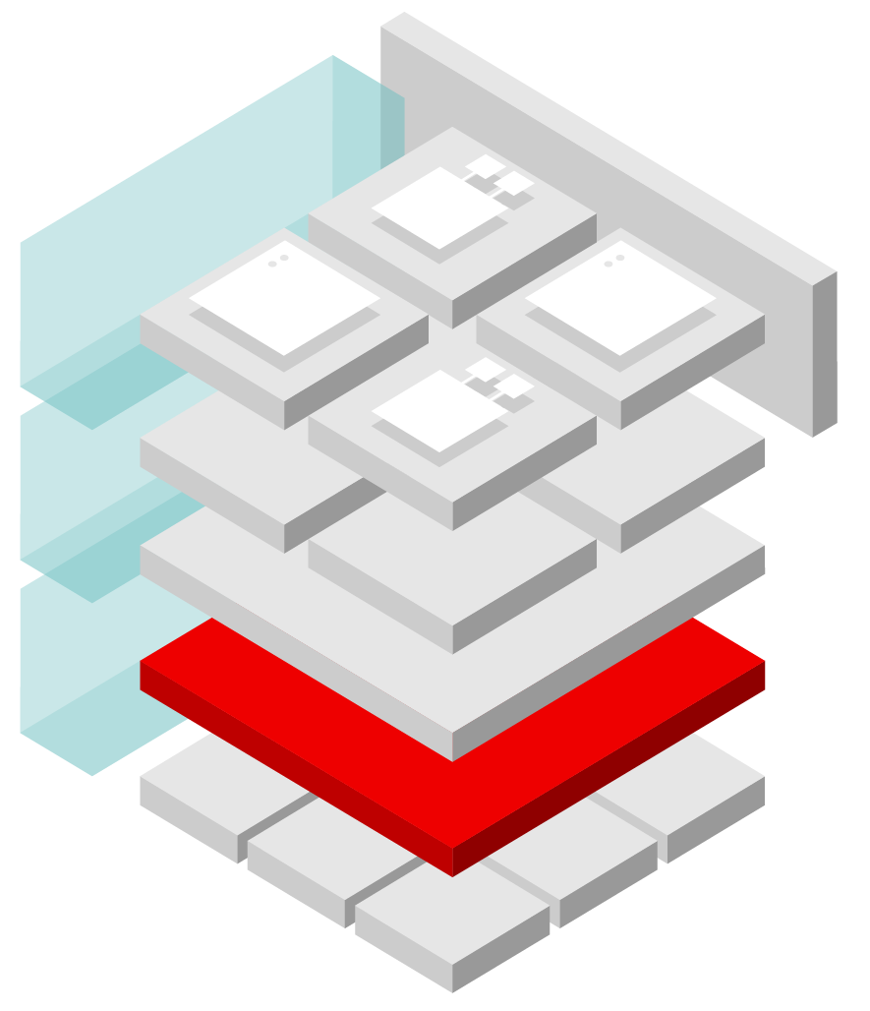
Red Hat 的混合云安全三层方法：
3
从坚实的基础开始
使用 DevSecOps 实践在混合云上实施可信软件供应链
管理、自动化和保护混合云
2
1
云基础设施
（裸机、虚拟化、公共云、私有云、边缘或组合）
Notes:
Speaker: Amy
At Red Hat, our people, processes, and technologies work together to allow customers to:
Mitigate their risk and meet compliance requirements across the application and infrastructure stack and life cycle, for both traditional and cloud-native environments.
Build an open hybrid cloud that helps them achieve their defense-in-depth objectives.
Take control of their hybrid cloud security and DevSecOps challenges by helping customers:
Build a security-focused hybrid cloud with a strong foundation.
Manage and control their security-focused hybrid cloud.
Implement security in application development using DevSecOps practices
Red Hat provides a resilient, security-focused foundation and trusted technologies so that customers can turn their focus to building, managing, and controlling hybrid environments, implementing an automation strategy, and developing robust applications with DevSecOps practices.

Slide 5

Red Hat Enterprise Linux 提供安全基础
安全设计的操作系统
通过完整性测量和远程证明增强安全启动
使用 SELinux 实现强制访问控制和多级安全性
系统范围的加密策略和 FIPS 验证的加密库
加密静态和动态数据
自动化安全与合规配置
Container Security
Manage access to host
Secure computing profile
Add / Drop Capabilities
Red Hat 通用基础映像 容器可以利用 RHEL
受信任且维护的内容
SELinux Context
Pod/container
Project C
Pod/containers
强化/优化的
操作系统
减少攻击面
受控的不变性
只读用户空间
事务更新
安全启动
网络绑定磁盘加密
Project A
Project B
Project B with service mesh
Software Defined Network (SDN) plug-in
Kubernetes
Red Hat Enterprise Linux CoreOS
Red Hat Enterprise Linux
Notes:
Speaker: Amy
Key message is that the security functionality we always invest in is critical for all workloads, not just containerized or traditional
Just as RHEL is the foundation to CoreOS, Container Images, the security that is inherently built in to RHEL is also passed through into OpenShift.
These protections, from SELinux, to strong cryptography, application sandboxing, confidential computing and more are the basis that will make running and developing AI workloads safer as well.
SELinux was key to preventing the container escape attacks and has prevented several CVE’s from being a factor, from RunCescape and ShellShock! And is only 1 in a myriad of capabilities that are built into every Red Hat product by default.
========================================================================
SELinux mandatory access controls provides an OS layer of security
Inherently Deny All, Verify All label-based security
Apply fine-grained level of control over files, processes, users and apps via SELinux policy
By default denied -> needs to exists allow rules
Customizable per application or container
Process isolation to mitigate attacks via privilege escalations
Provides container separation and protection
Prevent several CVEs: Runcescape, Shellshock!
Secure hardware root of trust helps verify system integrity
Integrity Measurement Architecture hashing works with Keylime remote attestation for integrity verification hardware-based trust
Fapolicyd prevents execution of rogue apps
Digital certificates stored on smart cards or hardware security modules defend against certificate theft attacks
Trusted Execution Environments use processor-based memory and execution encryption to provide confidentiality.
USB Guard to limit what types of devices connect to a system to prevent data theft
System wide cryptographic policies
The system-wide cryptographic policies is a system component that configures the core cryptographic subsystems, covering the TLS, IPsec, SSH, DNSSec, and Kerberos protocols. It provides a small set of policies, which the administrator can select.
When a system-wide policy is set up, applications in RHEL follow it and refuse to use algorithms and protocols that do not meet the policy, unless you explicitly request the application to do so. That is, the policy applies to the default behavior of applications when running with the system-provided configuration but you can override it if required.
The default system-wide cryptographic policy level offers secure settings for current threat models. It allows the TLS 1.2 and 1.3 protocols, as well as the IKEv2 and SSH2 protocols. The RSA keys and Diffie-Hellman parameters are accepted if they are at least 2048 bits long.
System Roles
RHEL System Roles address the automation and Orchestration part of ZTA by providing Ansible content to harden and configure a RHEL system.
System Role content is authored by RHEL Engineering (the subject matter experts on RHEL configuration) and works across multiple releases of RHEL.
Using RHEL System Roles eliminates bespoke or custom scripts that break with each OS update.
Of course, customers can configure systems at scale through the Ansible Automation Platform, which acts as a single place for logging of actions taken during configuration.

Slide 6



OpenShift 提供持续安全性
Control
Protect
Detect & Respond
ACM
Application Lifecycle & Locally
Fleet Management
Fleet Observability & Alerts
Vulnerability Analysis
Policy Admission Controller
Runtime Behavioral Analysis
ACS
App config Analysis
Compliance Assessments
Auto-suggest Network Policies
APIs for CI/CD integrations
Risk Profiling
Threat Detection / Incident Response
Trusted Content
Kubernetes Platform Lifecycle
Container Isolation
Container Registry
Identity & Access Management
Network Isolation
OCP
Build Management
Platform Data
Application Access & Data
CI/CD Pipeline
Deployment Policies
Observability
BUILD
DEPLOY
RUN
DevSecOps
Notes:
Speaker: Amy
Managing containers and Kubernetes requires a DevSecOps approach. OpenShift with RHACS & RHACM enable customers to implement DevSecOps for both the platform and the applications deployed on the platform.
We provide customers with the ability to control ability security at build time, protect the application platform at deploy time and detect and respond to runtime threats.
To control application security, Red Hat offers shift left security capabilities that enable customers to integrate security gates into their application pipeline.
This includes new offerings such as Trusted profile Analyzer, Trusted Artifact Signer (a productized instance of Sigstore) along with existing features such as OpenShift pipelines built with Kube-native Tekton and Tekton Chains for task run attestation and OpenShift GitOps.
To protect the platform, OpenShift leverage security capabilities in RHEL such as SELinux, and adds integrated IAM, as well as built-in deployment gates. ACM adds the ability to enforce configurations preventing drift.
OpenShift provides an opinionated, prehardened enterprise Kubernetes platform with automated configuration at Day 1. ACM provides automated fleet management with the ability to create, update and delete OpenShift clusters. OpenShift includes integrated identity management, that enables 2factor auth, as well as multiple options for encrypting platform data at rest and multiple security gates via OpenShift and ACS to prevent admission of content that does not meet security policies.
OpenShift provides multiple options for implementing network security. ACS adds runtime detection of threats, including privilege escalation and anomalous activity combined with the ability to automatically respond by scaling deployments to zero. ACM integrates with the monitoring stack for fleet observability and alerting. ACS provides detection of anomalous behavior and communication at runtime as well as the ability to recommend network policies based on observered communication patterns.
OpenShift, ACM and ACS together provide the features needed to help customers assess and maintain compliance with the technical controls from security and regulatory frameworks that apply to their OpenShift fleet. ACS provides assessment of workload compliance.
All of these features help to secure AI/ML applications from build to deploy to runtime.

Slide 7
机密计算概述

Slide 8
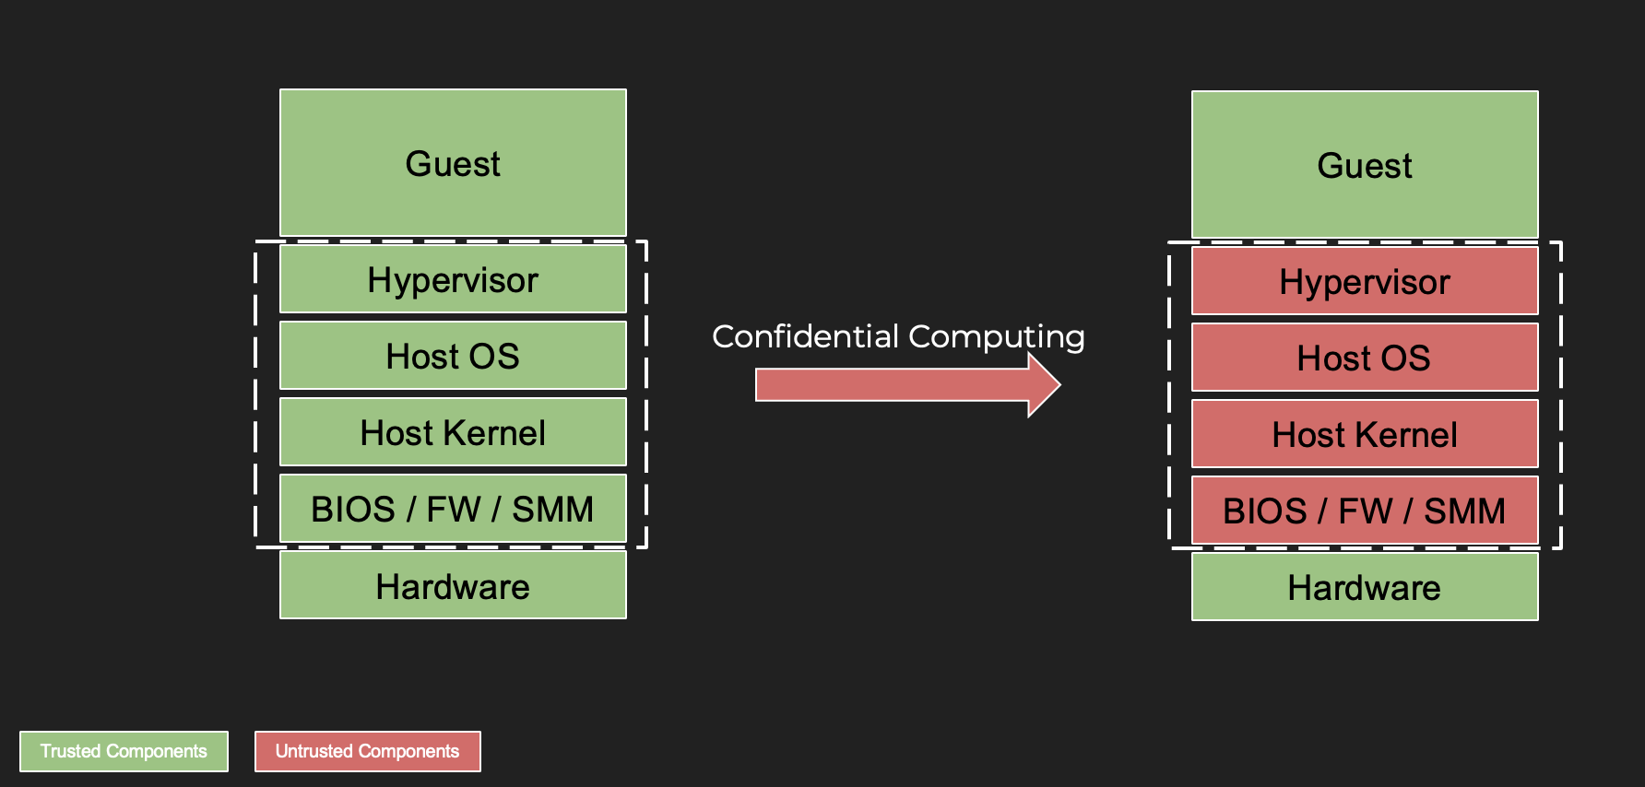
机密计算 – 云计算平台虚拟机的新安全模型

Slide 9
虚拟机的安全问题
VM
VM
VM
VM
VM
来自其他虚拟机的攻击
来自HyperVisor的攻击
HyperVisor

Slide 10
部分机密计算平台的解决方案
各个硬件供应商为增强计算平台安全性所做的努力，特别是在虚拟化和云环境中。它们提供内存加密、安全飞地和基于硬件的隔离等功能，以保护敏感数据和工作负载免受未经授权的访问和攻击, 例如：
AMD Secure Nested Paging (SNP)
Intel Total Memory Encryption (TME) and Intel Software Guard Extensions (SGX)
IBM Secure Execution for Linux （SE）
ARM Confidential Compute Architecture (CCA)
IBM Power Processor Encryption Facility (PEF)
海光 (H3C) Confidential Secure Virtualization (CSV)

Slide 11
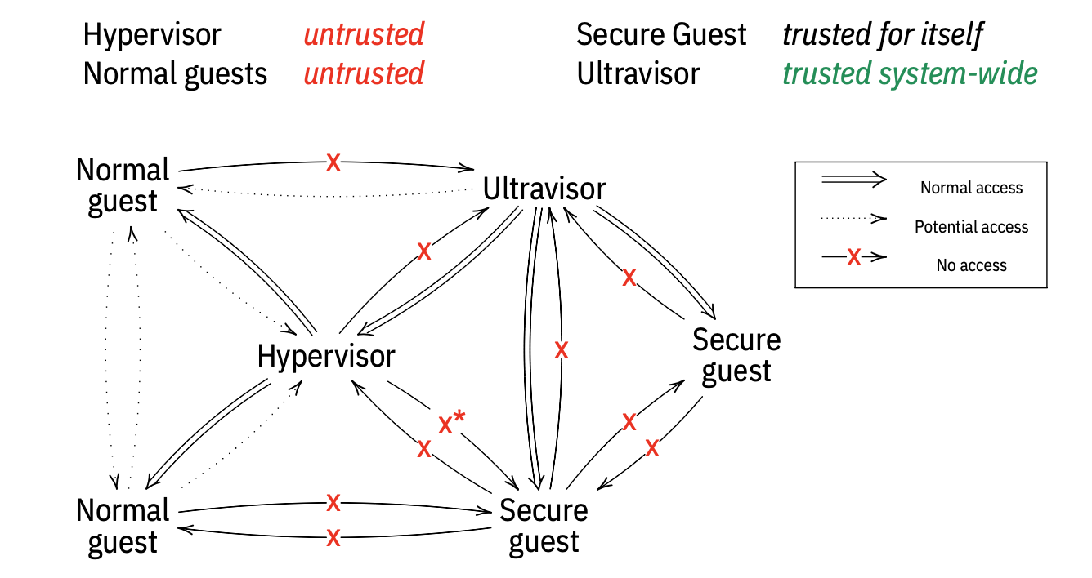
IBM Secure Excution – 零信任

Slide 12
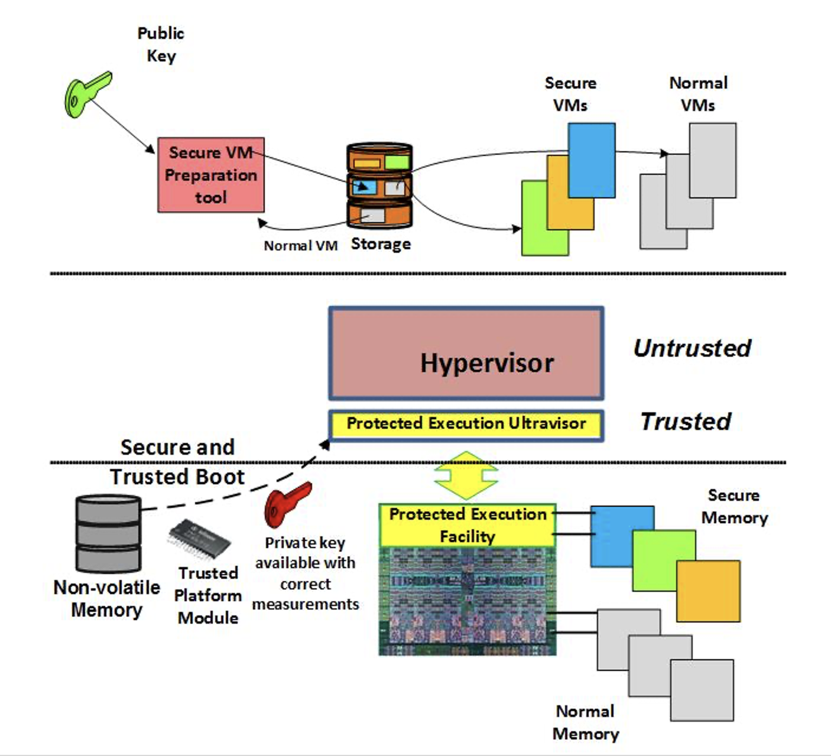
IBM Secure Excution – 内存安全

Slide 13
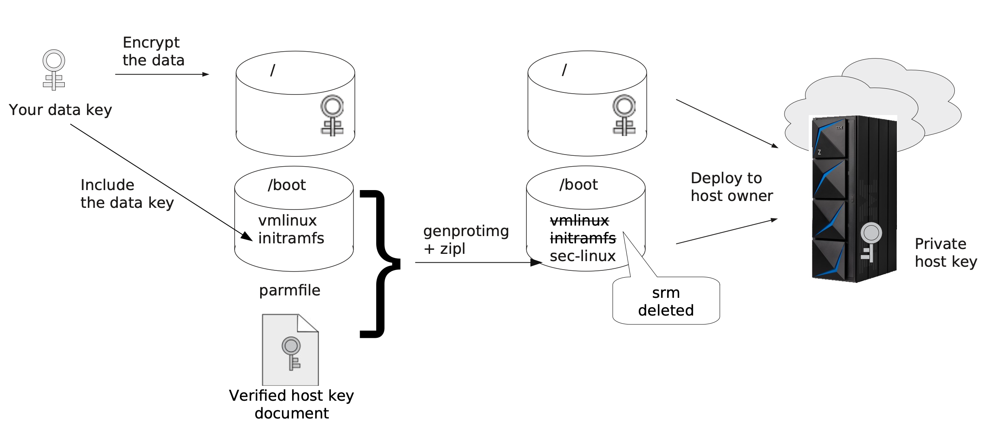
IBM Secure Excution – 数据安全

Slide 14
容器安全问题探讨

Slide 15
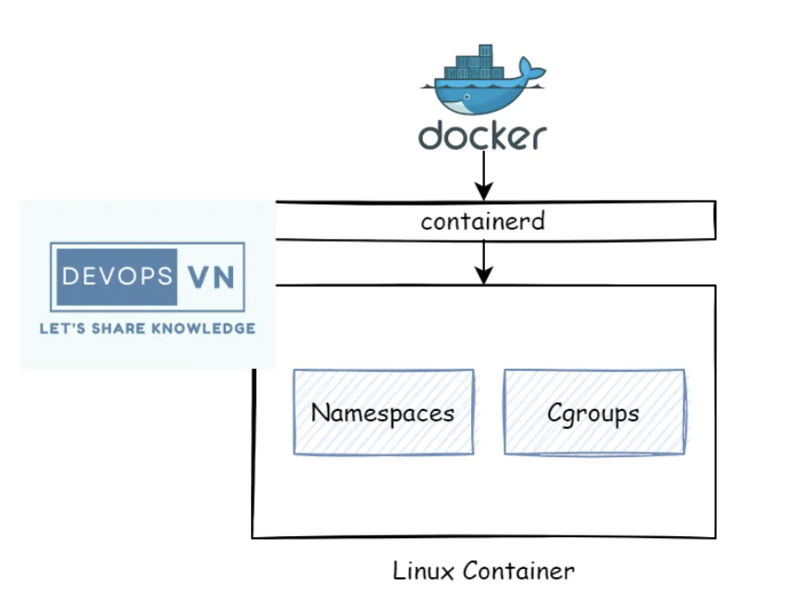
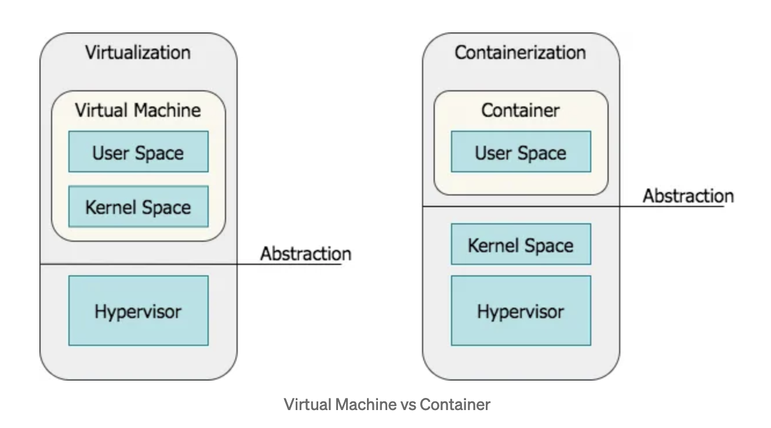
传统容器技术 – Namespace, Cgroups

Slide 16
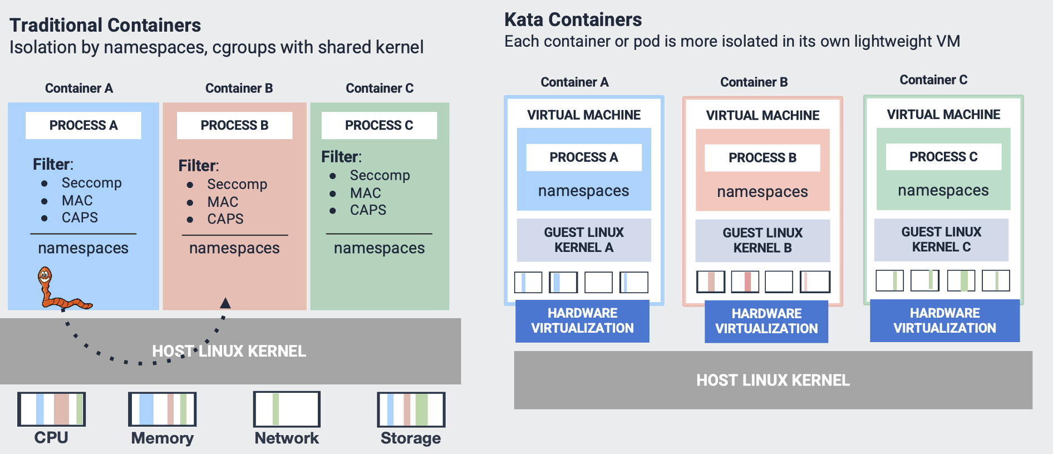
Kata Containers – 基于虚拟机的容器

Slide 17
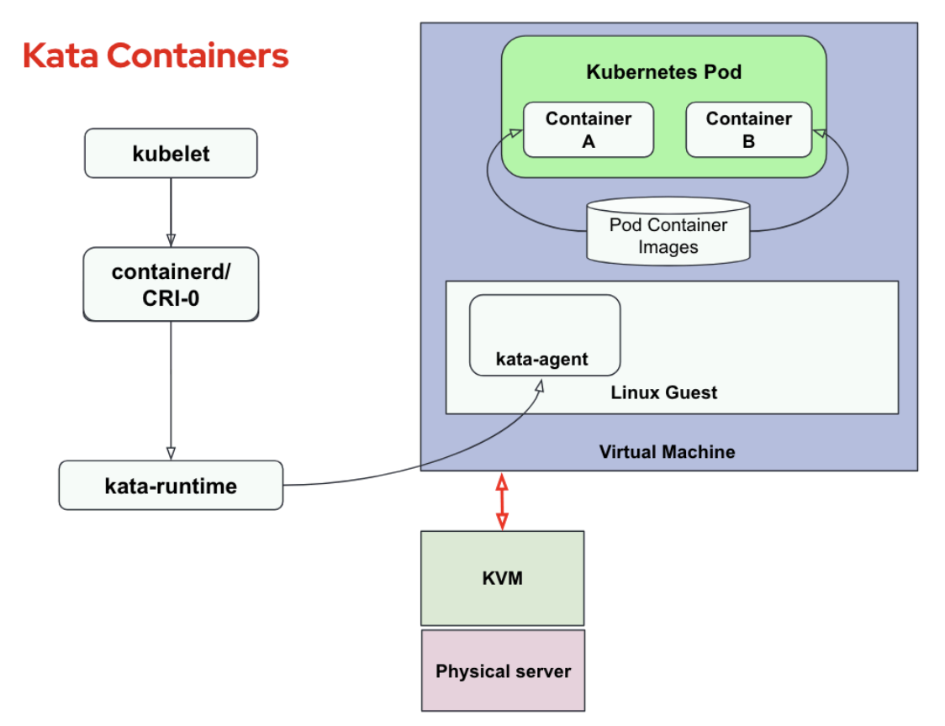
Kata Containers实现架构

Slide 18
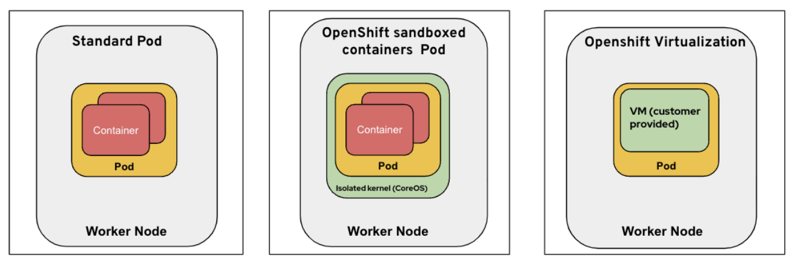
标准容器、沙箱容器和云原生虚拟化的异同

Slide 19
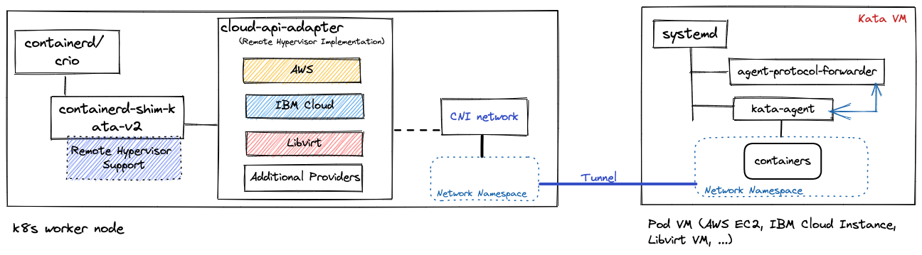
伴生容器 (Kata Remote HyperVisor + PeerPod)

Slide 20
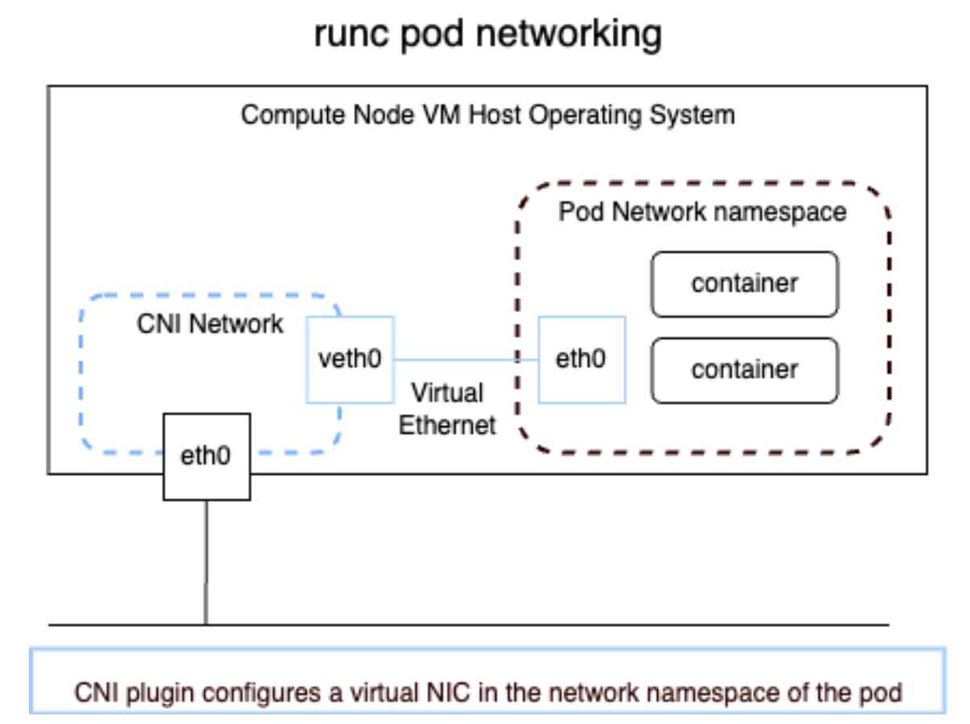
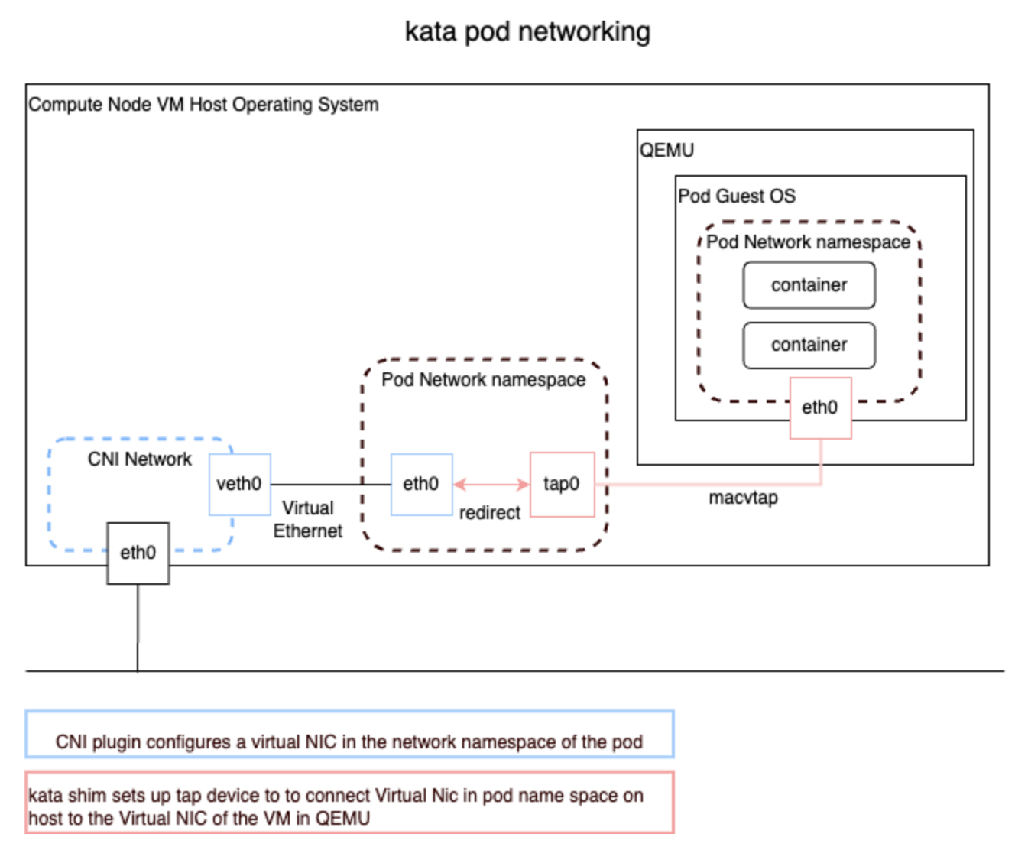
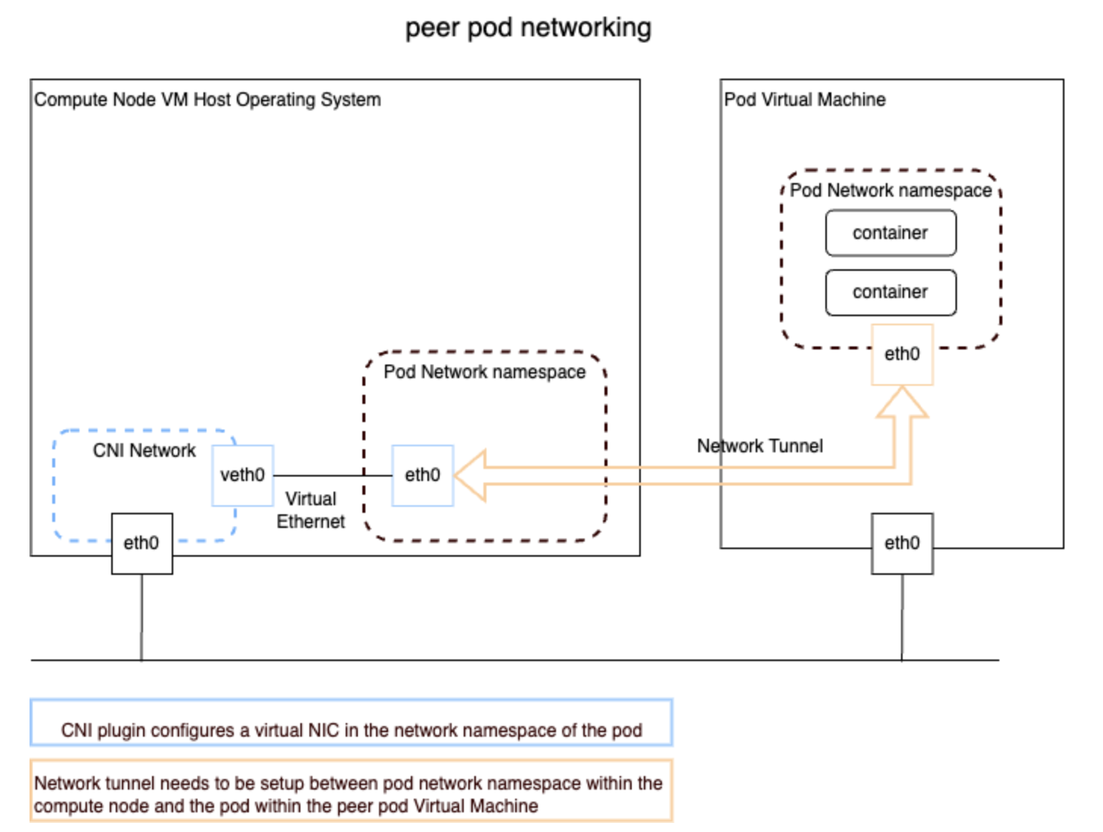
不同容器技术网络解决方案对比

Slide 21
伴生容器网络详解
Worker node VM
kubelet
IaaS cloud
API endpoint
Tunnel for agent protocol
Agent API requests and responses between kata-shim and kata-agent are transferred via a tunnel established between Cloud API Adaptor and Agent Protocol Forwarder
Tunnel for pod network
Incoming and outgoing packets of a pod running in a peer pod VM are transferred via a network tunnel between a worker node VM and peer pod VM
CRI
containerd
Shim API
kata-shim
Create
Request
Request
Agent protocol
Pod VM
Cloud API adaptor
Tunnel for agent protocol
Agent protocol forwarder
CNI
Configure
Kata agent
Create
Tunnel for pod network
Pod
Network namespace
container
CNI plugin
container
Configure
Pod network

Slide 22
伴生容器的 Volumes, secret, configmap
Worker node VM
kubelet
CRI
containerd
Shim API
kata-shim
Request
Agent protocol
Pod VM
Cloud API adaptor
Tunnel for agent protocol
Agent protocol forwarder
CopyFile
Kata agent
Create
Pod
container
Volume
Volume

Slide 23
伴生容器将OSC解决方案
扩展到裸机、虚拟化、公有云等多个场景
OSC on bare metal
OSC/peer-pods on hypervisor (ex. VMware)
OSC/peer-pods on public cloud (AWS, Azure)
Container
Pod
Container
Container
VM
Pod
Pod
OCP Worker Node
On bare metal
OCP Worker Node
on VMWare VM
OCP Worker Node
on CP Instance
Pod
Pod
VMWare VM
CP Instance
Physical server
Physical server
Public Cloud Provider

Slide 24
机密容器

Slide 25
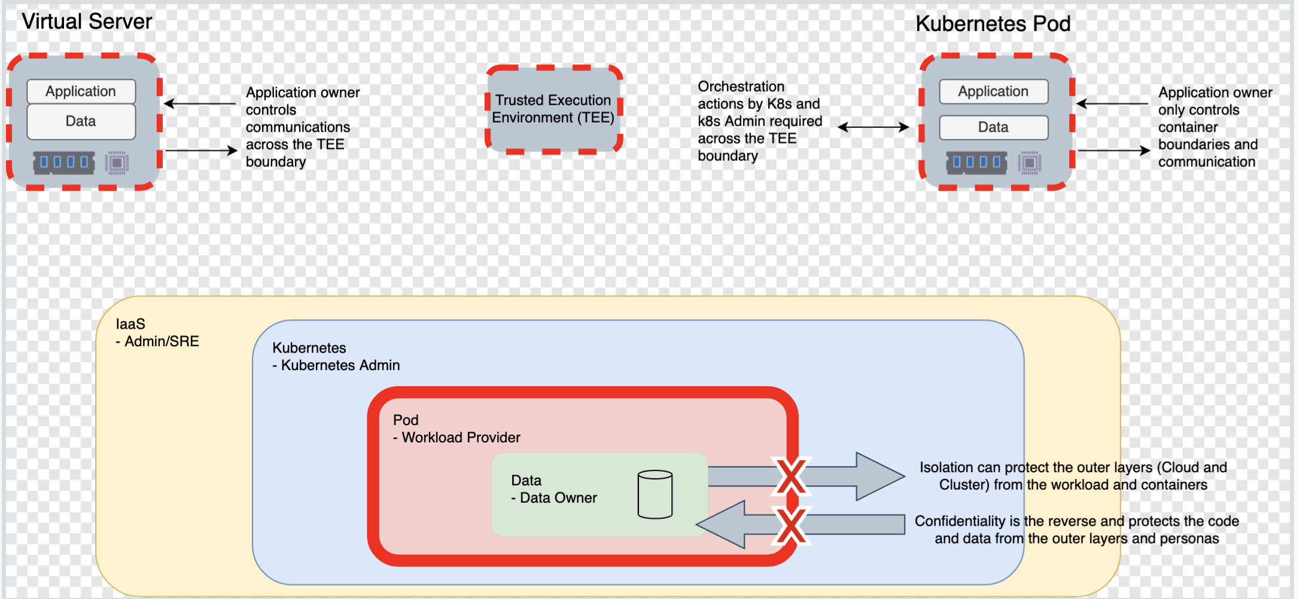
K8s 零信任

Slide 26
CNCF 机密容器项目历史
机密容器项目是标准化 Pod 级别的机密计算并简化其在 Kubernetes 中的使用。这使得 Kubernetes 用户能够使用熟悉的工作流程和工具来部署机密容器工作负载，而无需广泛了解底层机密计算技术。
Initialized in June 2020 by Intel, IBM, Redhat, Alibaba
Become CNCF Sandbox project in March 2022
Github org link and Slack channel
First relase in Sept 2022
Incubator on-going…
IBM and Redhat contributions
Initializers
Leaders
Key committers

Slide 27
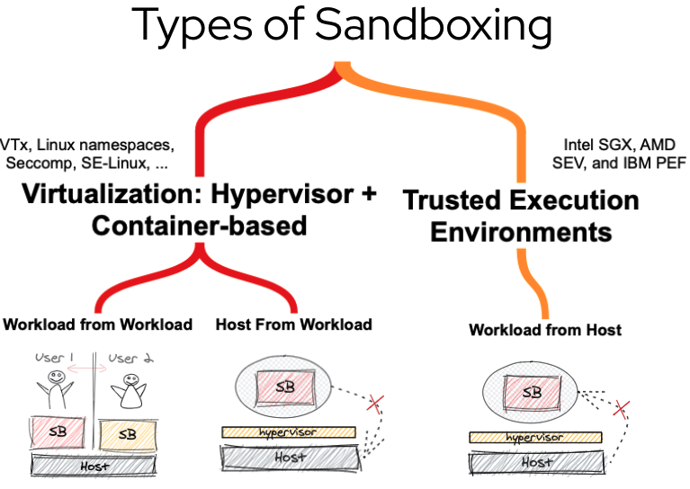
基于虚拟化技术的机密容器
I

Slide 28
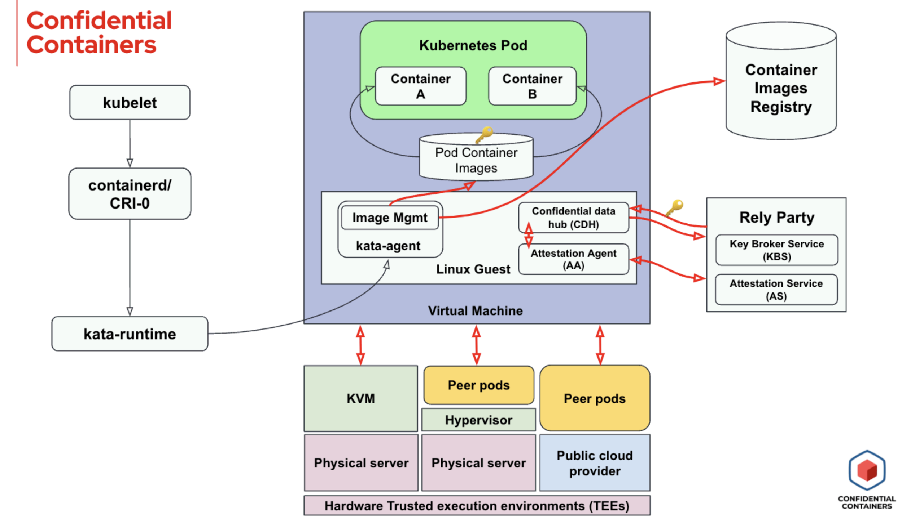
机密容器的架构

Slide 29
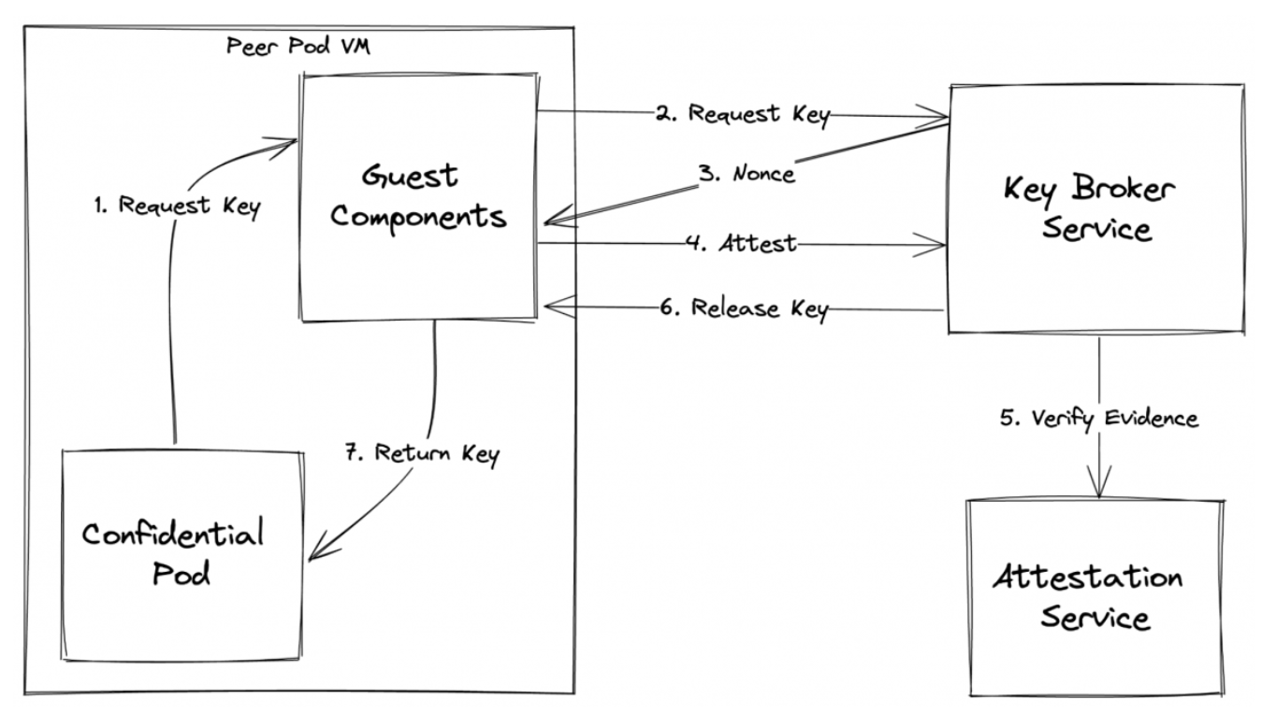
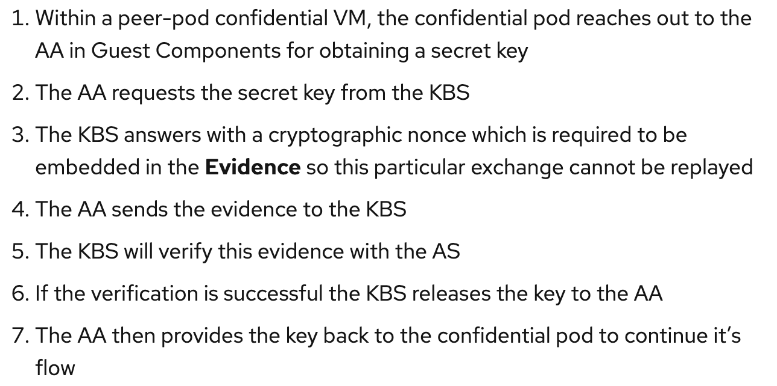
机密容器 流程详解

Slide 30
机密容器典型用例

Slide 31
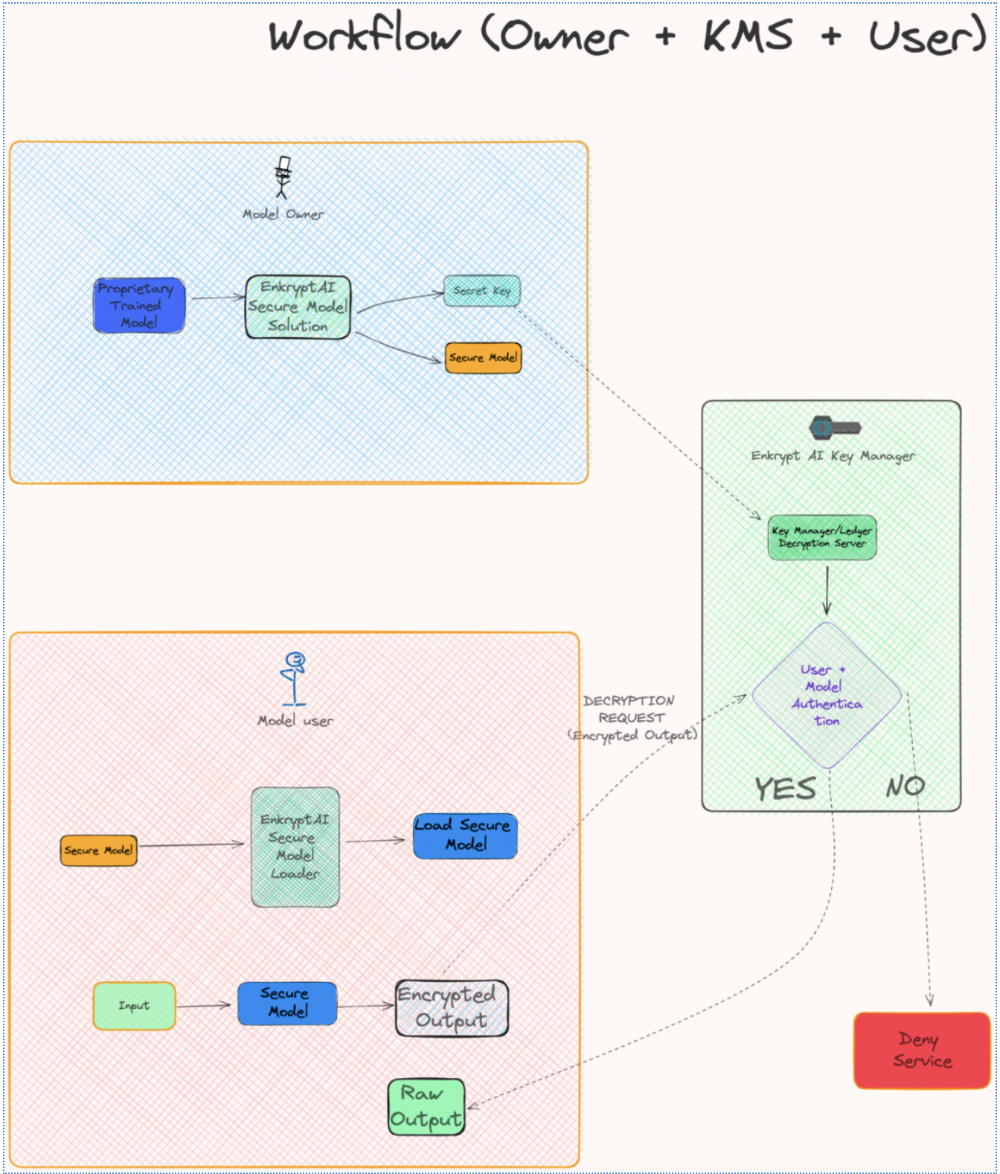
Enkrypt AI
- 模型所有者：模型开发人员，将经过训练的模型转换为安全模型
- 模型用户：希望将模型部署在其计算基础设施上的最终用户，加载安全模型并与其交互，推送数据并获取结果
- 密钥管理器：管理解密的私钥
Flow：
The model is first encrypted with enhanced security and deployed by the model owner
The model owner is the one pushing the private key into the Enkrypt AI key manager
The model user is the one sending the requests with the encrypted output to be decrypted with that key
Raw data is sent back to the model user after decryption

Slide 32
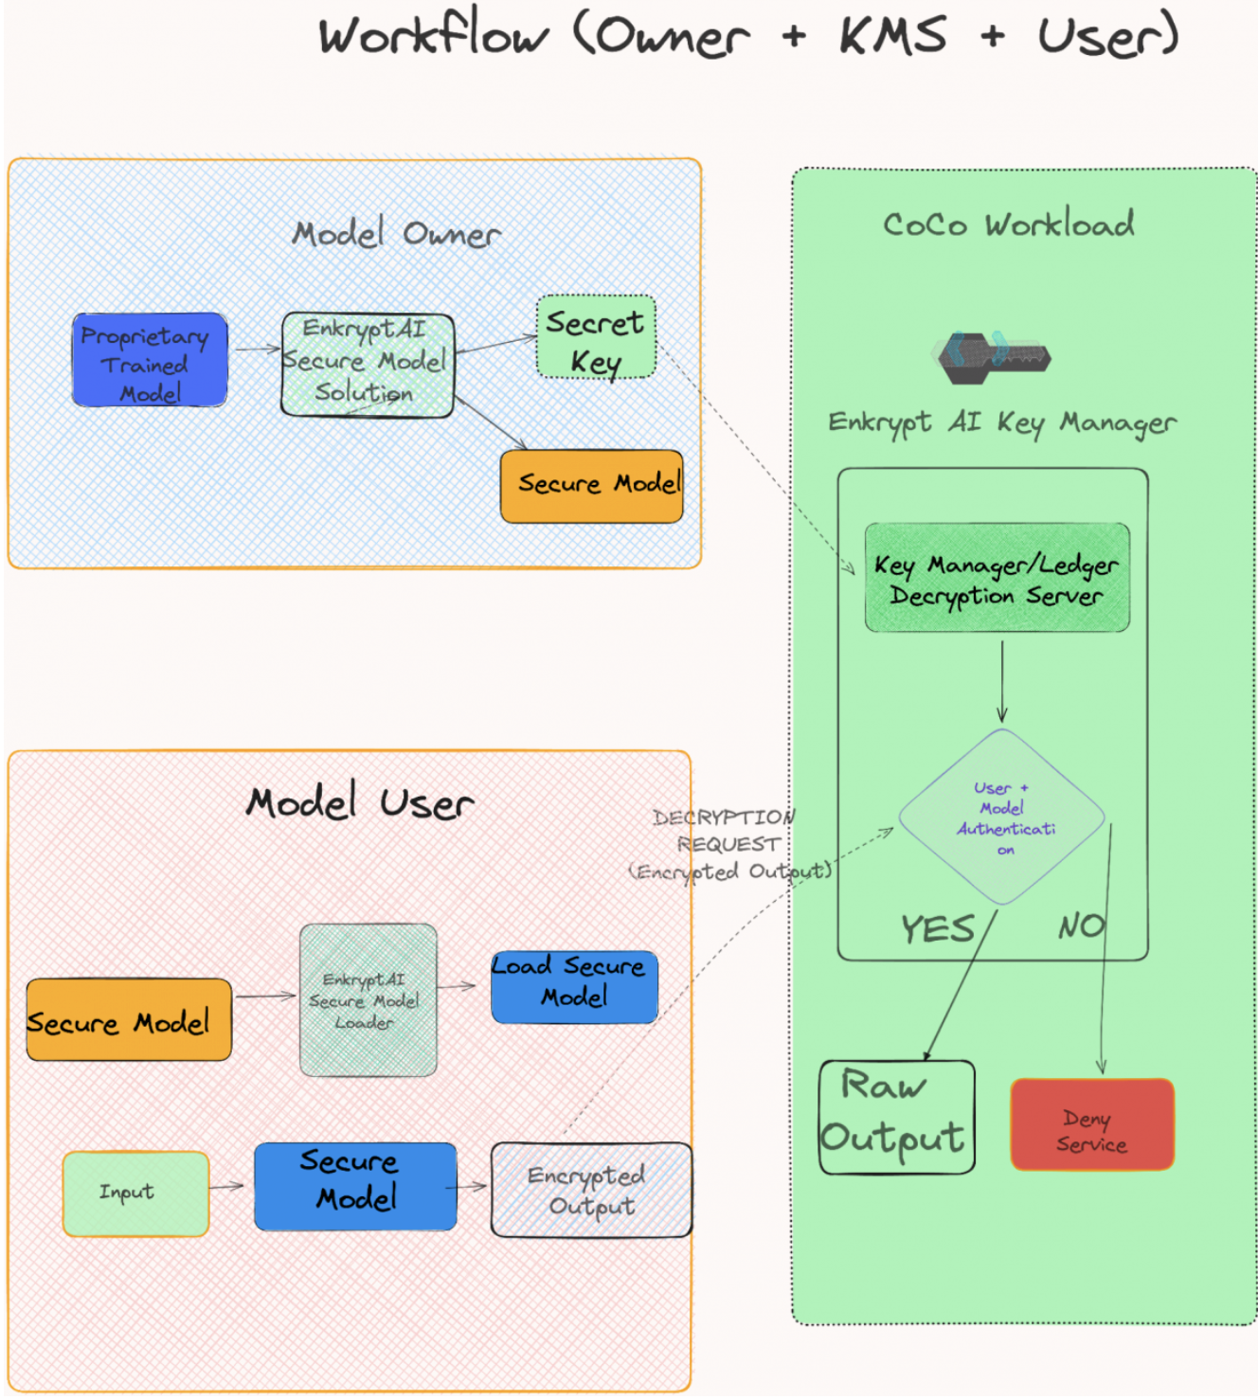
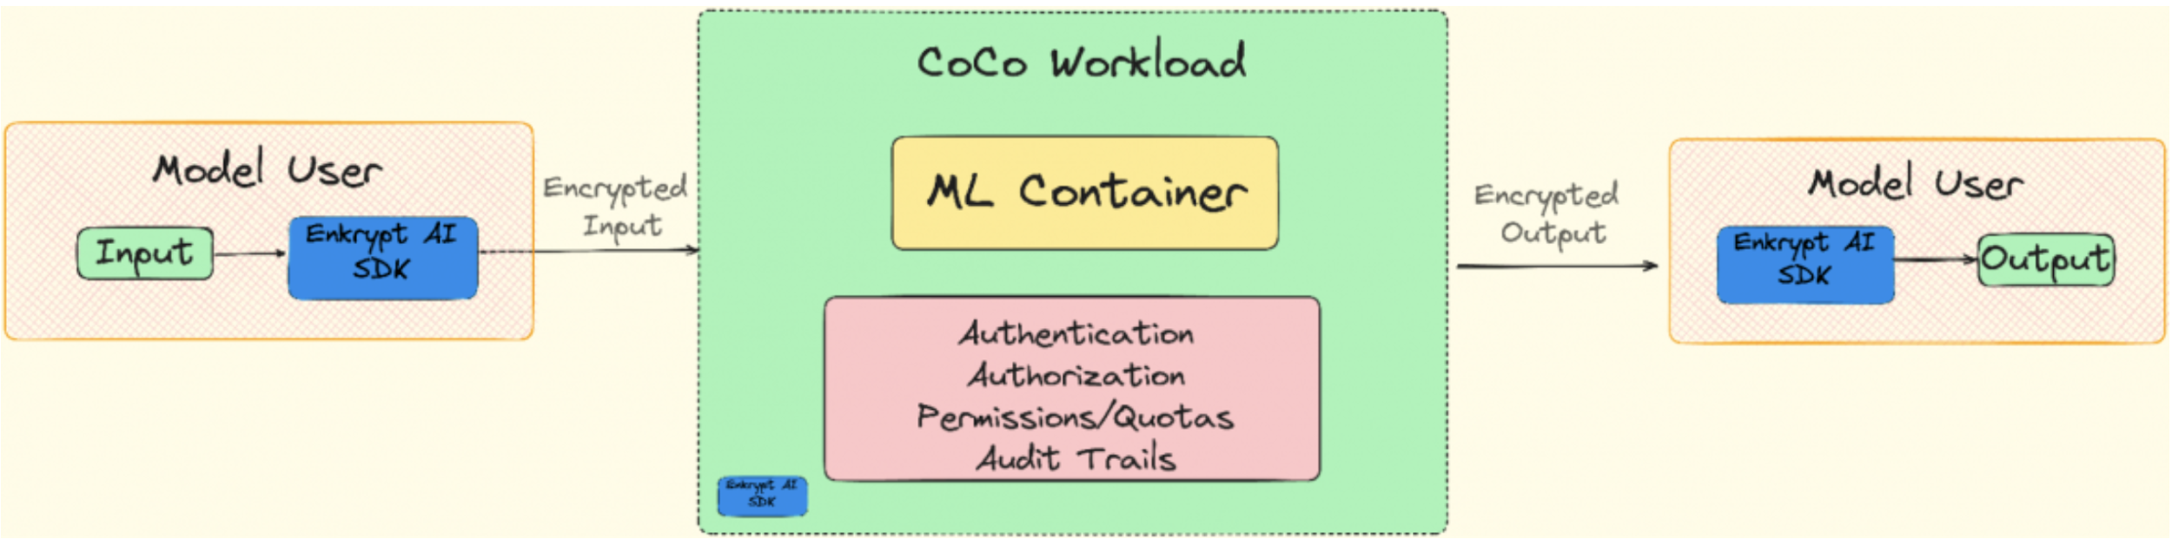
Enkrypt AI CoCo
Enkrypt AI 密钥管理器作为机密容器部署在可信执行环境中，以在运行时保护代码和密钥。

Slide 33
Demo: Securing AI Models with EnkryptAI deployed as confidential containers on Red Hat OpenShift
https://www.youtube.com/watch?v=XLOWuI7J8wE

Slide 34
未来展望

Slide 35
Red Hat Enterprise Linux
Roadmap for Confidential Computing Enablement
Images
Attestation
Virtualization
针对云平台优化的 RHEL 机密计算镜像
机密容器工作负载的加密或签名镜像库
用于验证机密虚拟机和工作负载（TEE 和虚拟机完整性）的认证服务
RHEL 主机与 TEE 硬件和证明服务配合使用，安全地托管机密虚拟机
Notes:
Amy

Slide 36
OpenShift Sandboxed Containers (OSC)
Short Term (today)
Mid Term (1- 6 month)
Long Term
(> 6 month)
Peer Pods GA (AWS and Azure) - Flexible VM sizes - FIPS support - Pre-built PodVM images
Confidential Containers Dev Preview (Azure)
Support for IBM z Tech Preview
Confidential Containers Tech Preview (Azure)
QEMU and cri-o support for Kata Rust Components
Nvidia GPU Support for Peer Pods
Confidential Containers GA
CoCo Support for IBM z GA
ARO integration with support for Confidential Containers
Hypershift support
Peer Pods persistent volume support
NVidia Confidential GPU support
Sandboxed Containers
Sandboxed Containers
Sandboxed Containers
‹#›
Disclaimer: This roadmap is subject to change without notice
Notes:
Martin

Slide 37
Thank you

